Slide 1
Rails-05
3870

Slide 2
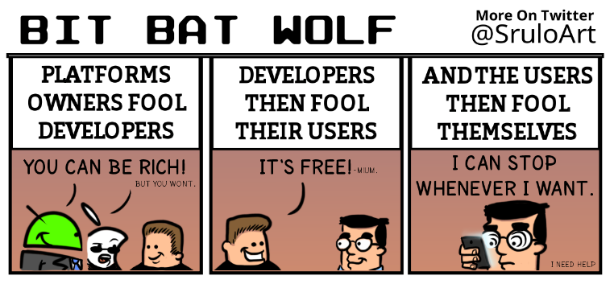
Notes:
From: https://twitter.com/iamdevloper

Slide 3
Scaffolds
Scaffolds are great but let's not
use them yet…
rails destroy scaffold User
(if you have been following the book)
We will start using Scaffold once we are more familiar with Rails

Slide 4
generate resource
A resource route maps a number of related requests to actions in a single controller
http://guides.rubyonrails.org/routing.html#resource-routing-the-rails-default
rails g resource User email password_digest
Notice that it inserts the following in routes:
resources :users

Slide 5
what is a resource?
Trying the following command to see the routes generated by "resources :users"
rake routes
Do you see the routes generated by the following?
resources :users

Slide 6
Allowing users to signup
Don't forget to create tables by running
rake db:migrate
and make sure you add
gem 'bcrypt', '3.1.7'
to your Gemfile
Don't forget to place a link to the sign-up page:
<%= link_to "Please Sign Up!", new_user_path, class: "btn btn-lg btn-primary" %>
Notes:
http://en.wikipedia.org/wiki/Bcrypt

Slide 7
User model
class User < ActiveRecord::Base
has_secure_password
validates_uniqueness_of :email
end
# the model now accepts password and
# password_confirmation to generate
# password_digest
Notes:
http://api.rubyonrails.org/classes/ActiveModel/SecurePassword/ClassMethods.html

Slide 8
User controller
class UsersController < ApplicationController
def index
redirect_to new_user_path
end
def new
@user = User.new
end
def create
@user = User.new(params.require(:user).permit(:email,:password,:password_confirmation))
if @user.save
redirect_to root_path, notice: "Thanks for signing up!"
else
render "new"
end
end
end
Notes:
Later when we create the sessions controller, we might want to add session[:user_id] = @user.id
So that the user will be logged in as soon as an account is created

Slide 9
New user form: new.html.erb
<%= form_for @user do |f| %>
<% if @user.errors.any? %>
<%= "Error in form" %>
<ul>
<% @user.errors.full_messages.each do |message| %>
<li><%= message %></li>
<% end %>
</ul>
<% end %>
<%= f.label :email %><br/>
<%= f.text_field :email %><br/>
<%= f.label :password %><br/>
<%= f.password_field :password %><br/>
<%= f.label :password_confirmation %><br/>
<%= f.password_field :password_confirmation %><br/>
<%= f.submit %>
<% end %>

Slide 10
Exercise
Add some users and verify that they have been added using rails console command

Slide 11
Cookies 1
cookie: a small amount of information sent by a server to the browser, and then sent back by the browser on future page requests
cookies are used for authentication, user tracking, user preferences, shopping carts, etc
cookies data consists of single name/value pair
(sent in header of the client's HTTP GET or POST request)

Slide 12
Cookies 2
session cookie: default type, temporary cookie that is stored only in the browser's memory
persistent cookie: stored in a file on the browser's computer

Slide 13
Session 1
An abstract concept to represent a series of HTTP requests and responses between a specific Web browser and server
(http://guides.rubyonrails.org/security.html#sessions for your info on how Rails handles sessions)
Sessions vs cookies
a cookie is data stored on the client
a session's data is stored on the server (only 1 session per client)

Slide 14
Session 2
sessions are often built on top of cookies:
the only data the client stores is a cookie holding a unique session ID
on each page request, the client sends its session ID cookie, and the server uses this to find and retrieve the client's session data

Slide 15
Session 3
Client’s browser makes an initial request to the server
Server notes client’s IP address/browser, stores some local session data, and sends a session ID back to client
Client sends that same session ID back to server on future requests
Server uses session ID to retrieve that data for the client’s session later, like a ticket given at a coat-check room

Slide 16
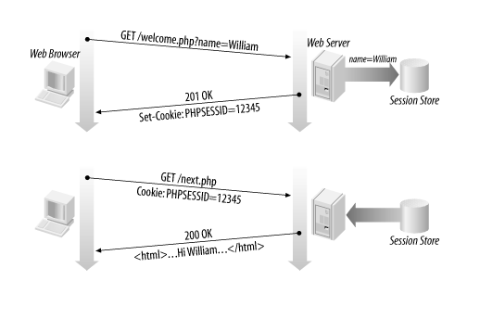
Notes:
http://www.justinweiss.com/blog/2015/03/17/how-rails-sessions-work/

Slide 17
Authentication
To create authentication we need the sessions controller
rails g controller Sessions new
Go ahead and add the following in routes:
resources :sessions
Check rake routes to confirm generated routes

Slide 18
Log in form
<h1>Log In</h1>
<%= form_tag sessions_path do %>
<%= label_tag :email %><br/>
<%= text_field_tag :email, params[:email] %><br/>
<%= label_tag :password %><br/>
<%= password_field_tag :password %><br/>
<%= submit_tag "Log In" %>
<% end %>

Slide 19
Sessions Controller 1
class SessionsController < ApplicationController
def new
end
def create
user = User.find_by_email(params[:email])
if user && user.authenticate(params[:password])
session[:user_id] = user.id
redirect_to root_path, notice: "Logged in!"
else
flash.now.alert = "Email or password is invalid"
render "new"
end
end
end

Slide 20
Sessions Controller 2
# in the sessions controller
# add destroy method for user to log out
def destroy
session[:user_id] = nil
redirect_to root_path, notice: "Logged out!" end

Slide 21
Application Controller
class ApplicationController < ActionController::Base
# Prevent CSRF attacks by raising an exception.
# For APIs, you may want to use :null_session instead.
protect_from_forgery with: :exception
private
def current_user
@current_user ||= User.find(session[:user_id]) if session[:user_id]
end
helper_method :current_user
end

Slide 22
Show user as logged in
<% if current_user %>
<li style="text-color:#fff; font-size:25px;">
Logged in as <%= current_user.email %>
</li>
<%= link_to "Log Out", session_path("current"), method: "delete" %>
<% else %>
<li>
<%= link_to "Log in", new_session_path %>
</li>
<% end %>

Slide 23
Authorize method
class ApplicationController < ActionController::Base
# Prevent CSRF attacks by raising an exception.
# For APIs, you may want to use :null_session instead.
protect_from_forgery with: :exception
private
def current_user
@current_user ||= User.find(session[:user_id]) if session[:user_id]
end
helper_method :current_user
def authorize
redirect_to new_session_path, alert: "Not authorized" if current_user.nil?
end
end

Slide 24
Restricting action to logged in users
class HomeController < ApplicationController
before_filter :authorize, only: [:new,:edit]
def create
Quote.create(body: params[:body], author: params[:author])
redirect_to quote_path, notice: "Quote added!"
end
def new
end
def edit
@quote = Quote.find(params[:id])
end
def update
q = Quote.find(params[:id])
q.update(body: params[:body], author: params[:author])
end
end

Slide 25
Exercise
Add new users and restrict access to logged in users when it comes to creating or updating a resource

Slide 26
Name routes
Used named routes to makes URLs prettier in your project:
get 'signup', to: 'users#new', as: :signup
get 'login', to: 'sessions#new', as: :login
get 'logout', to: 'sessions#destroy', as: :logout

